Slide 1
Applied Natural Language Processing
Dr. Sucharitha Shetty

Slide 2
Table of Contents
Optimizers

Slide 3
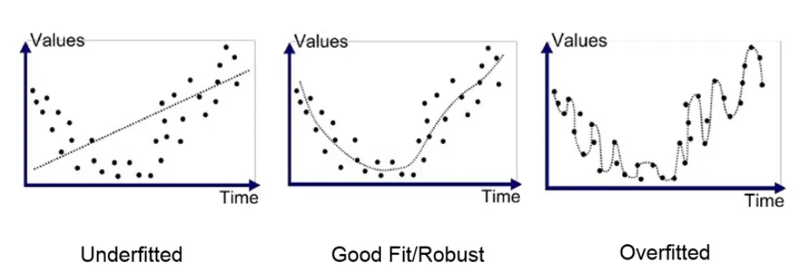
Formal definition of Deep Learning
Train vs Test vs Validation data
Dataset-
Training- model training – 1. Train 2.Validation-[Basically for hyper parameter tuning]
Test (model doesn’t see this)-model testing
[If it is seen it is an issue of data leakage]

Slide 4

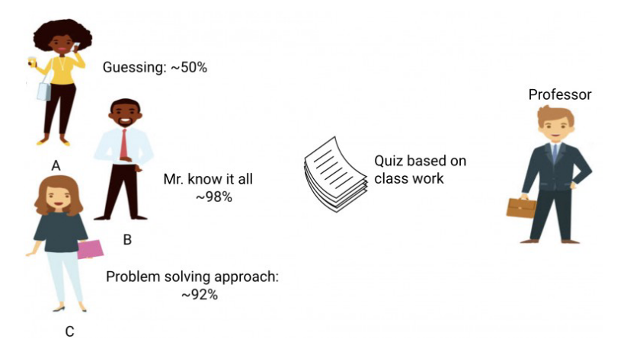
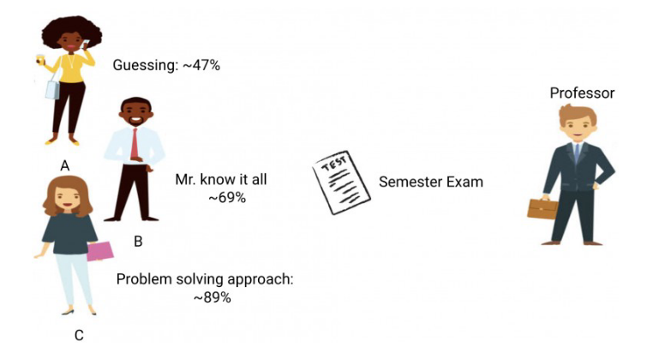

Slide 5
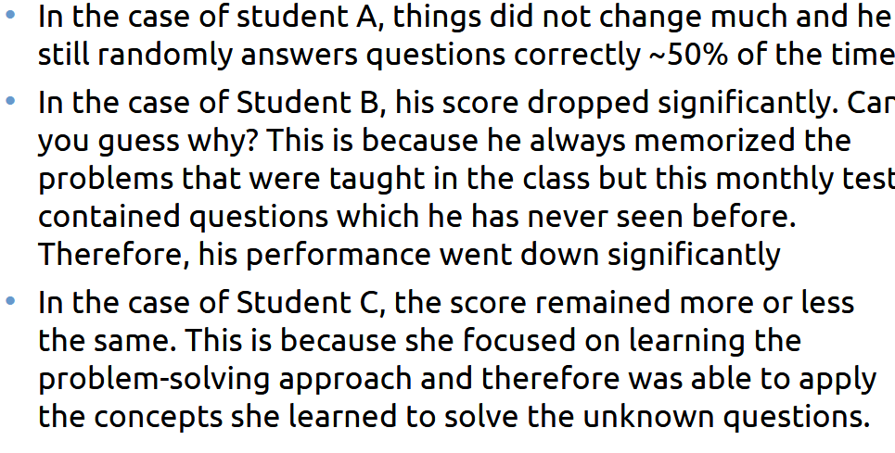

Slide 6
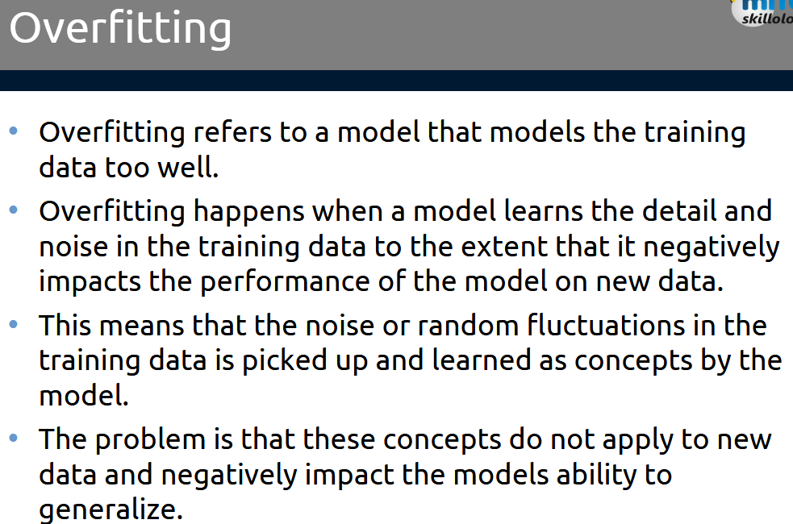

Slide 7
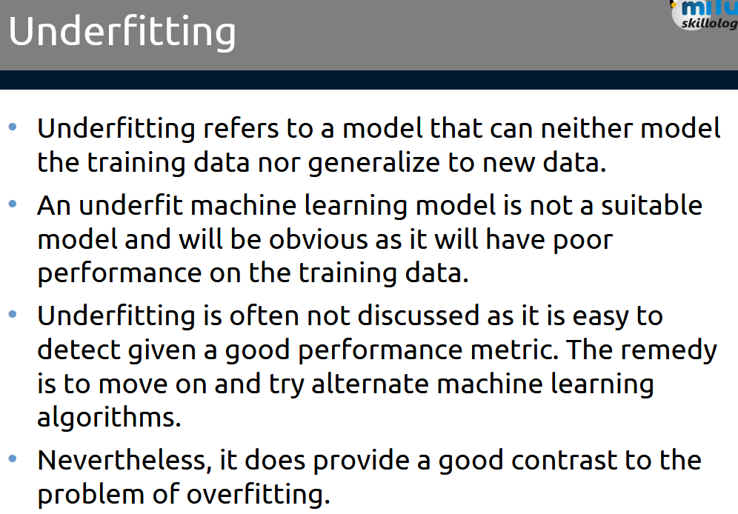

Slide 8
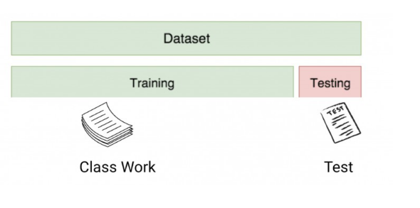
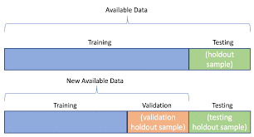
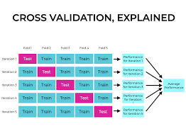

Slide 9
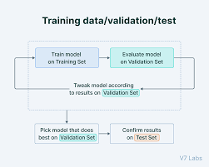
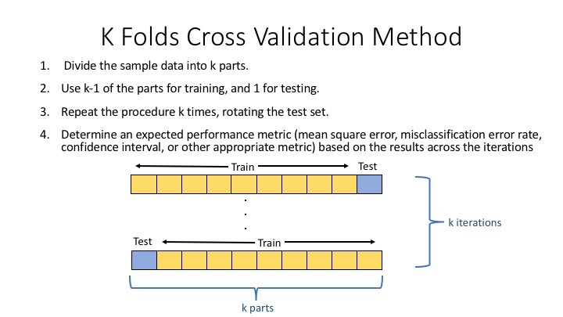

Slide 10
Optimizers
In Natural Language Processing (NLP), optimizers are algorithms used to adjust the parameters (weights and biases) of a neural network model to minimize the loss function and improve performance

Slide 11
Understanding the Role of Optimizers
Optimizers help neural networks learn by adjusting weights and biases using gradients from the loss function. Choosing the right optimizer affects:
Convergence speed — How fast the model learns.
Stability — Preventing erratic updates or divergence.
Generalization — How well the model performs on unseen data.

Slide 12
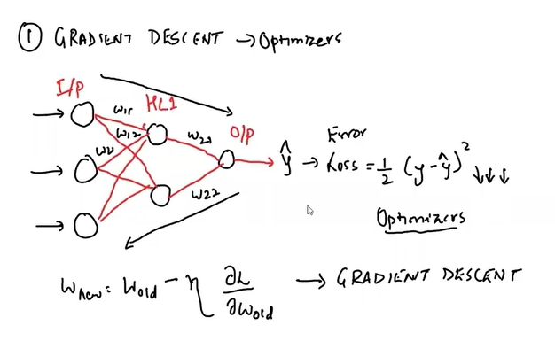

Slide 13
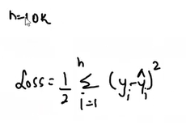
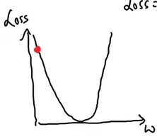
Defn
Epoch – The number of times the algorithm runs on the whole training dataset.
Dataset -10k records, train model for 20 epochs (in every epoch take 10k records do back propagation) –Gradient Descent ( 10k then back propogation then next round again 10k)
What if dataset becomes more than 1 million records- huge RAM, how many weights, convergence will happen slowly

Slide 14

Defn
Stochastic Gradient Descent (SGD) instead of all records do one record at a time every front and back propoagation
1 epoch how many iterations for 10k 10 iterations of forward and backward iteration
10k -20 epochs -> 10k*20 iterations- convergence will be very slow

Slide 15
Stochastic Gradient Descent (SGD)
Stochastic Gradient Descent (SGD) instead of all records do one record at a time every front and back propoagation
1 epoch how many iterations for 10k 10 iterations of forward and backward iteration
10k -20 epochs -> 10k*20 iterations- convergence will be very slow

Slide 16
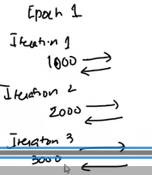
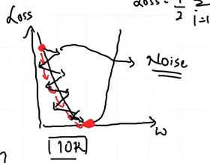
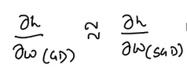
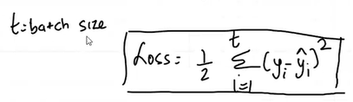
Mini-Batch SGD
20 epochs -10k dataset -1000batch size
Every epoch some batch size then do back propagation
In every epoch 10 iterations means in epoch 1 we can do 10 iterations forward and backward
Noise- it will take time to converge as we are updating batch wise
Less computational expenses

Slide 17
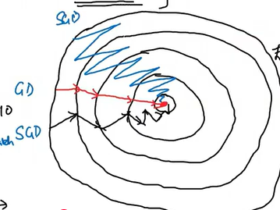
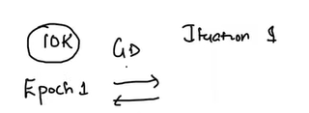
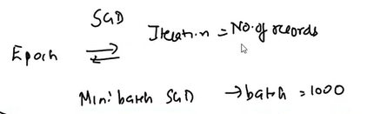

Mini-Batch SGD

Slide 18
Optimizers - two categories
First-Order Optimizers — These rely only on first-order gradients (e.g., SGD, Adam).
Second-Order Optimizers — These use second-order derivatives for improved convergence (e.g., Newton’s Method, L-BFGS).

Slide 19
First-order optimizers
Algorithms used in machine learning to update model weights by relying solely on the first-order derivatives (gradients) of the loss function to navigate toward a minimum. They are preferred for large-scale deep learning due to computational efficiency compared to second-order methods

Slide 20
Optimizers - two categories
Optimizers help neural networks learn by adjusting weights and biases using gradients from the loss function. Choosing the right optimizer affects:
Convergence speed — How fast the model learns.
Stability — Preventing erratic updates or divergence.
Generalization — How well the model performs on unseen data.

Slide 21
Gradient Descent

Slide 22
Optimizers
Why Random Forest in place of decision tree

Slide 23
Thank You

